Slide 1
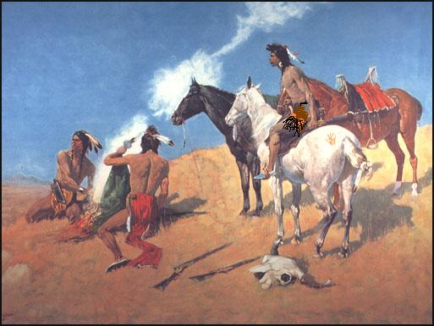
Look at the picture and answer the following questions.

Slide 2
What does the picture represent ?

Slide 3
What are they doing ? and why ?

Slide 4
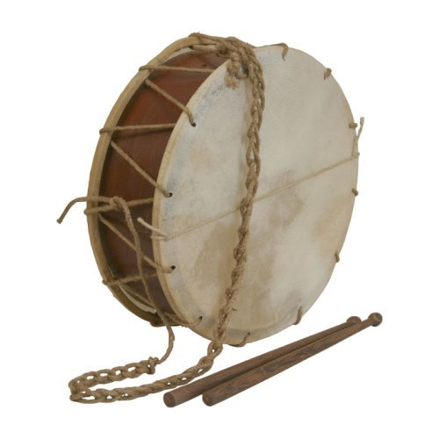
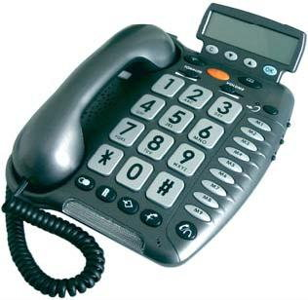
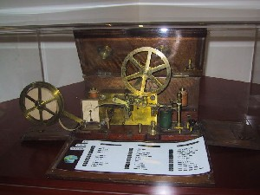
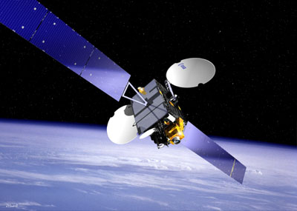
Write the following words in the boxes below Drum – Telegraph – Telephone - Satellite

Slide 5
Write the following words in the boxes below
-Drum
-Telegraph
-Telephone
-Satellite

Slide 6
What do all the items represented in pictures 1-4 above refer to ?Circle the correct letter A, B, C or D .
A- The developement of the radio
C- The start of telecommunications
B- The developement of telecommunications
D- The developement of satellite system

Slide 7
What do all the items represented in pictures 1-4 above refer to ?Circle the correct letter A, B, C or D .
A- The developement of the radio
C- The start of telecommunications
B- The developement of telecommunications
D- The developement of satellite system

Slide 8
Guess when the items in the pictures above were invented.Write the names of the items in column A.
Name of item | Date / Time period
 | Ancient times
 | 1876
 | 1890s
 | Mid-twentieth century

